Slide 1
A different outlook on stock-flow tasks.
Using eye tracking methodology to explore eye movements of problem solvers
Hubert Korzilius, Eline de Jong, Stephan Raaijmakers
Institute for Management Research / European Master in System Dynamics
EURO 2015 Glasgow 12-15 July 2015

Slide 2
Introduction
Behavioral Operational Research (BOR) and Systems Thinking (Hämäläinen, Luoma, & Saarinen, 2013)
          “Behavioral effects can relate to […] the possibility of procedural mistakes and cognitive biases”(p. 623)
Hämäläinen et al. (2013) BOR research agenda should contain:
          Behavioral and cognitive aspects
          People in problem solving situations
In this study we focus on behavioral and cognitive aspects in problem solving situations
We applied Systems Thinking inventory tasks to investigate this using Eye tracking methodology
Notes:
among others

Slide 3
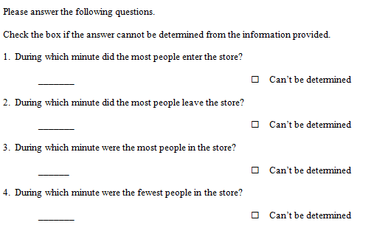
Introduction
Previous research on systems thinking inventory tasks, such as the Department Store Task
Notes:
Incorrect answers on time 8 and time 17
Criticism by Hämäläinen et al (2013) stating that the task is flawed as it may focus participants’ attention on an improper frame.
However, a big stream of research has focused on this task and comparable tasks, e.g. bath tub task and bank task, have produced similar results many people have problems understanding accumulation as evidenced by stocks and flows.

Slide 4
Introduction
Research revealed
          DST is difficult (e.g. Booth Sweeney & Sterman, 2000; Cronin, Gonzalez, & Sterman, 2009)
          Incorrect answers
          Use of correlation heuristic as explanation
Black box
Try to open black box by means of think aloud and eye tracking
Notes:
evt Hamalainen et al. 2013 noemen

Slide 5
Introduction
Think aloud experiment on revealed answering patterns (Korzilius, Raaijmakers, Rouwette, & Vennix, 2014):
          Correct ‘stock-reasoning’
          Correlation heuristic
          Virtual absence of reasoning
Recommendation: use Eye tracking as complementary method
Notes:
Use of a mix of reasoning strategies
Need for additional information

Slide 6
Introduction
Eye tracking: eyes don’t lie
          Continuous and non-evasive indices of attention to visual stimuli (Glaholt & Reingold, 2011)
          Close interaction between conceptual and perceptual processes (Carpenter & Shah, 1998)
          Sensitive method to study the rationale and biases of problem solving (Field, Mogg, & Bradley, 2004)
          Without having to rely on the verbal skills of the participants
Notes:
Eye tracking provides continuous and non-evasive indices of attention to visual stimuli without having to rely on the verbal skills of the participants (Glaholt & Reingold, 2011).
Veldhuis and Korzilius (2012) advise eye tracking to establish how individuals view graphs used in problem solving tasks and to establish how they process the information contained in the graphs
It forms a sensitive method to study the rationale and biases of problem solving (cf. Field, Mogg, & Bradley, 2004).
We use eye tracking to reveal the relation between viewing and answering behavior when solving a stock-flow task.
Hence, this study connects SD to the field of experimental psychology.
reveals “close interaction between conceptual processes, such as interpreting labels and scales, and perceptual processes, such as encoding and interpreting the slopes and patterns of the lines themselves” (Carpenter & Shah, 1998, p. 75)

Slide 7
Research objective and research questions
          In order to increase insight in the way individuals solve stock-flow tasks we use eye tracking to explore the relation between viewing and answering behavior
        While solving the Department Store Task, does the viewing behavior of the participants prelude answering behavior?
          What is the answering behavior?
          What is the viewing behavior?
          What is the relationship between viewing and answering behavior?
Notes:
Eye tracking provides continuous and non-evasive indices of attention to visual stimuli without having to rely on the verbal skills of the participants (Glaholt & Reingold, 2011).
Veldhuis and Korzilius (2012) advise eye tracking to establish how individuals view graphs used in problem solving tasks and to establish how they process the information contained in the graphs
It forms a sensitive method to study the rationale and biases of problem solving (cf. Field, Mogg, & Bradley, 2004).
We use eye tracking to reveal the relation between viewing and answering behavior when solving a stock-flow task.
Hence, this study connects SD to the field of experimental psychology.
Stephan
RQ Does viewing behavior prelude answering behavior, and if so, how?
RQa What is the answering behavior?
RQb What is the viewing behavior?
RQc What is the relationship between viewing and answering behavior?
How do the participants look while solving the Department Store Task?
Does viewing behavior prelude answering behavior, and if so, how?

Slide 8
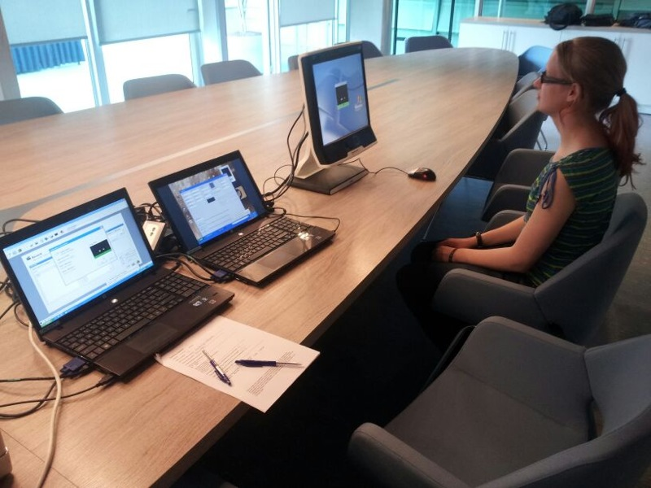
Method: Participants + procedure
Students from Radboud University, the Netherlands (N = 38)
27 males and 10 females
Mean age was 21.4 (SD = 1.52, range 18-25)
Eye tracker:
          Mobile Tobii T120
Notes:
Participants were from the alpha (n = 2), beta (n = 18), and gamma (n = 17) disciplines
Approx. in fourth year of their study (SD = 1.22, range 1-6)
No or little knowledge of systems dynamics
Participation was voluntary and no reward was granted

Slide 9
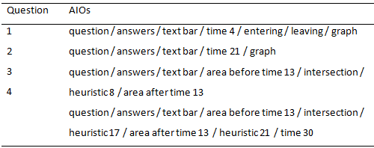
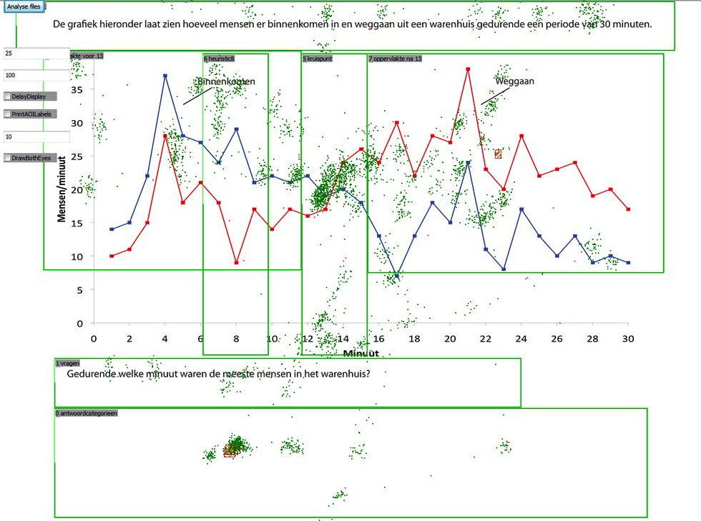
Method: Measures
        Eye fixation: Duration (in ms)
        Areas of interest (AOIs)
          Pictures of eye fixations are processed
          Area viewed > 50% of participants → important area, and then defined as AOI
Differentiated AOIs per question
Example of one participant (Q3)
Notes:
Fixation duration and AOIs were used to explore viewing patterns and answering patterns. AOIs were established on the basis of movies of the raw eye tracking data of all participants.
As such, viewing and reading a region on the screen was considered as an AOI. Table 1 lists the differentiated AOIs per question.
AOI answer: is special as this ends a viewing and thus thinking cycle (…)

Slide 10
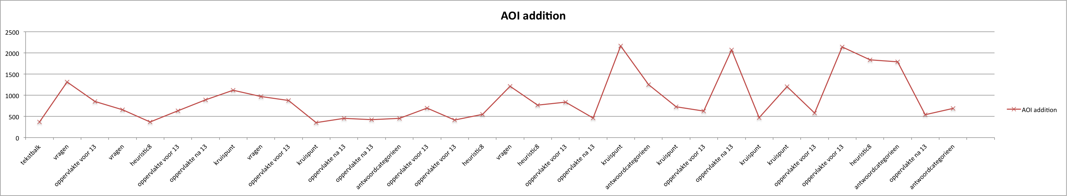

Method: Definitions
        Threshold 350 ms
        Frequency: number of AOIs used per question
        Duration: number of ms used per AOI / question
        Cycle: sequence of AOIs ending with AOI ‘answer’
        Temporal location: position of AOI in a cycle
        Global: five sequential AOIs in a specific range of duration (upper bound: 68% of highest peak; lower bound 350 ms)
        Sequence transitions: count of switches between AOIs
Notes:
(Jacob & Karn, 2003)
In order to prevent noise influencing our results we used a threshold of 350 ms.
This level was determined by either not having too much noise nor too much loss of information.
Global five sequential AOIs in a specific range of duration
rode markering van AOIs op de x-as gebruiken voor bespreken frequency, duration, cycle
groen is voor temporal location
blauwe band voor global
-bepaald % AOIs binnen ondergrens en bovengrens valt (noodzakelijk niet voldoende voorwaarde)
stel top 4000 ms dan BG = 1/4 (te bepalen) * 4000 = 1000 en OG = 350 ms want vastgesteld
68% van alle AOIs valt tussen OG en BG van bepaald aantal ms
kan nog versnipperd zijn, daarom 2e eis
-bepaald % AOIs achter elkaar in bandbreedte valt (noodzakelijk niet voldoende)
er moet minimaal 5 (te bepalen) aansluitende AOIs in bandbreedte vallen
Position measure: AOI
Position duration measure: fixation duration
Dwell time: The period of time that a system or element of a system remains in a given state
Fixations (transitions): number, proportion and rate

Slide 11
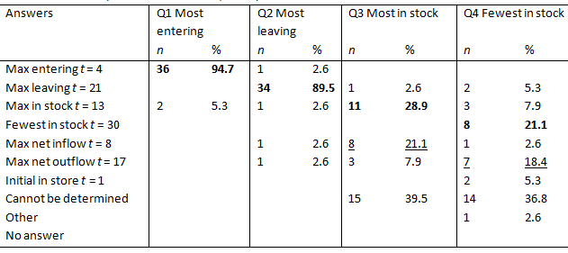
Results: Answering behavior
Group | Finding | Label | n
1 | Q3 intersection and Q4 t30 | Correct | 7
2 | Q3 t8 and Q4 t17 | Correlation heuristic | 6
3 | Q3 and Q4 cannot be determined | Cannot be determined | 14
4 | Q3 and Q4 incorrect, answers other than groups 1-3 | Miscellaneous | 11
Notes:
Groups based: both answers correct / correlation heuristic / cannot be determined
We decided to focus on groups 1, 2, and 3 and not on 4 because this group was diverse in their answers (as well as viewing behavior)
Comparable with other research.
15.8% of the participants answered Q1 to Q4 correctly.
Only a minority gave correct answers to Q3 and Q4 (28.9% and 21.1%, respectively).
The importance of the correlation heuristic was also corroborated. In addition, a relatively large part of the participants chose to answer with ‘cannot be determined’. Based on the answers given we preliminary conclude that task performance was not influenced by the method of eye tracking.
On basis of the answers of Q3 and Q4 four groups were differentiated

Slide 12
Results: Testing hypotheses on viewing behavior 1
        Group 1 looked more frequently at intersection and time 30 than groups 2 and 3
          Finding
            Intersection: 1 > 3
            Time 30: 1 > 2, 3
        Group 2 looked more frequently at heuristic 8 and heuristic17 than groups 1 and 3
          Finding
            Heuristic 8 : 2 > 1, 3
            Heuristic 17: 2 > 1, 3
Notes:
Hypotheses based on dimensions of viewing behavior and group differentiation

Slide 13
Results: Testing hypotheses on viewing behavior 2
        Group 2 spent more time (duration) at heuristic 8 and heuristic17 than groups 1 and 3
          Finding
            Heuristic 8 : 2 > 1, 3
            Heuristic 17: 2 > 1, 3
        Number of cycles of group 1 was larger than that of group 2
          Finding
            Question 4: 1 > 2

Slide 14
Results: Testing hypotheses on viewing behavior 3
        Group 1 looked more often at intersection and time 30 directly before answer (temporal location) than groups 2 and 3
          Finding
            Intersection: 1 > 2
        Group 2 looked more often at heuristic 8 and heuristic 17 directly before answer (temporal location) than groups 1 and 3
          Finding
            Heuristic 8: 2 > 1
Notes:
Directly is defined as 1 or 2 AOIs before answer

Slide 15
Results: Testing hypotheses on viewing behavior 4
        Group 1 looked more global than groups 2 and 3
          Finding
            Question 4: 1 > 2, 3
Notes:
Global
Look consecutively at different AOIs (five) in a band with 350 ms and 68% of longest duration

Slide 16
Results 5: Exploration sequences 1
Question 3 GROUP 1
 | answers | question | intersection | text bar | area after time 13 | heuristic 8 | area before time 13
answers | x | 3 | 3 | 1 | 5 | 0 | 0
question | 1 | x | 6 | 0 | 1 | 3 | 0
intersection | 9 | 2 | x | 1 | 6 | 7 | 6
text bar | 0 | 6 | 2 | x | 0 | 0 | 1
area after time 13 | 2 | 1 | 12 | 0 | x | 0 | 3
heuristic 8 | 1 | 0 | 0 | 0 | 0 | x | 12
area before time 13 | 2 | 0 | 8 | 3 | 8 | 3 | x
        3 times answers precedes question
        1 time question precedes answers
        Gamma = (P-Q)/(P+Q)
        Gamma “question precedes answers” = (1-3)/(1+3) = -.50
Notes:
In line with Poole and Roth (1989) surface if there is a best order of phases.
3* answers question
1* question answers
use table of gamma

Slide 17
Results 5: Exploration sequences 2
Gamma Question 3 GROUP 1
 | answers | question | intersection | text bar | area after time 13 | heuristic 8 | area before time 13
answers | x | 0,50 | -0,50 | 1,00 | 0,43 | -1,00 | -1,00
question | -0,50 | x | 0,50 | -1,00 | 0,00 | 1,00 | -
intersection | 0,50 | -0,50 | x | -0,33 | -0,33 | 1,00 | -0,14
text bar | -1,00 | 1,00 | 0,33 | x | - | - | -0,50
area after time 13 | -0,43 | 0,00 | 0,33 | - | x | - | -0,45
heuristic 8 | 1,00 | -1,00 | -1,00 | - | - | x | 0,60
area before time 13 | 1,00 | - | 0,14 | 0,50 | 0,45 | -0,60 | x
Precendence score | 0,10 | 0,00 | -0,03 | 0,04 | 0,14 | 0,10 | -0,30
Seperation score | 0,74 | 0,60 | 0,47 | 0,71 | 0,30 | 0,90 | 0,54
        Preliminary sequence based on Precedence score:
          Area after time 13, Answers, Heuristic 8, Text bar, Question, Intersection, Area before time 13
        Separation score:
          Heuristic 8 most clearly separated: less often precedes or follows other AOIs
        → No clear picture yet
Notes:
1.0 indicates complete separation; 0 complete overlap
In line with Poole and Roth (1989) surface if there is a best order of phases.

Slide 18
Results: Summary Groups 1 and 2
        Group 1
          Looked more frequently at AOIs intersection and time 30
          Looked more often at AOIs intersection and time 30 directly before answers
          Number of cycles > 2
          Looked more global
        Group 2
          Looked more frequently at AOIs heuristic 8 and heuristic 17
          Looked more often at AOIs heuristic 8 and heuristic 17 directly before answers
          Spent more time at AOIs heuristic 8 and heuristic 17
Notes:
Eline: literatuur die specifiek in eye tracking naar answering behavior kijkt
antwoord op een

Slide 19
Conclusions 1
        RQ While solving the Department Store Task, does the viewing behavior of the participants prelude answering behavior?
          What is the answering behavior?
          Four groups were distinguished: Correct, Correlation heuristic, Cannot be determined, and Miscellaneous answers
          What is the viewing behavior?
          What is the relationship between viewing and answering behavior?
Notes:
Without Outside AOIs and LOSSes
RQ1 How do the participants look while solving the Department Store Task?
Specific AOIs: question / answers / text / time 4, 8, 13, 17, 21, 30, area before 13, area after 13
On average 2 viewing cycles
On average 20 seconds per question

Slide 20
Conclusions 2
        RQ While solving the Department Store Task, does the viewing behavior of the participants prelude answering behavior?
          What is the answering behavior?
          What is the viewing behavior?
          Groups 1 and 2 paid specific attention to their characteristic areas of interest
          What is the relationship between viewing and answering behavior?
Notes:
Without Outside AOIs and LOSSes
RQ1 How do the participants look while solving the Department Store Task?
Specific AOIs: question / answers / text / time 4, 8, 13, 17, 21, 30, area before 13, area after 13
On average 2 viewing cycles
On average 20 seconds per question

Slide 21
Conclusions 3
        RQ While solving the Department Store Task, does the viewing behavior of the participants prelude answering behavior?
          What is the answering behavior?
          What is the viewing behavior?
          What is the relationship between viewing and answering behavior?
          Frequency and temporal location seem to function as precursors for answering behavior
Notes:
Jacob and Karn (2003) Frequency reflects the importance of the area
Interaction between thinking and viewing
Volgordelijkheid?
Without Outside AOIs and LOSSes
RQ1 How do the participants look while solving the Department Store Task?
Specific AOIs: question / answers / text / time 4, 8, 13, 17, 21, 30, area before 13, area after 13
On average 2 viewing cycles
On average 20 seconds per question

Slide 22
Discussion
Confirmation that eye tracking is a useful, yet labor intensive and time-consuming, method to study the rationale and biases of problem solving (cf. Field et al., 2004).
Opened the black box: shedding light on the way individuals solve systems thinking inventory tasks (cf. Korzilius et al., 2014)
Ongoing research: Further exploration is needed to identify sequences and patterns
Valuable for Behavioral Operational Research helping to unravel problem solving strategies
Notes:
Hamaleinen

Slide 23
Questions?
Thank you!

Slide 24
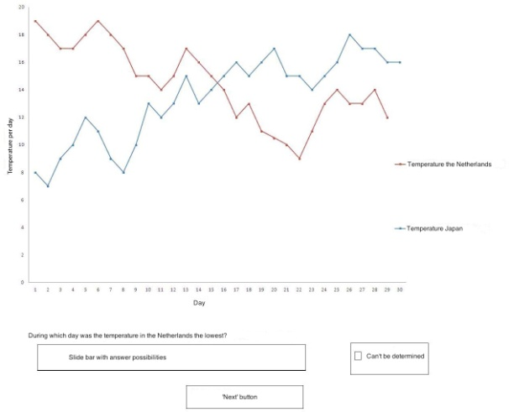
Method
Procedure
Seated 60 cm from the computer monitor
Eye movements were calibrated
Introduction screen with a short explanation how to answer the questions
Training task
Start experiment started
Afterwards fill-out questionnaire
Word of thanks
Notes:
Upon arrival
the researcher explained the procedure; participants were asked
In a random fashion blue dots with a black point in the middle were presented on the screen. Participants were asked to fixate on the black point. This was repeated until all points were successfully calibrated. to sit in an comfortable position and to keep this position and not to move their head during the experiment.
training task a graph with temperatures in Japan and the Netherlands

Slide 25
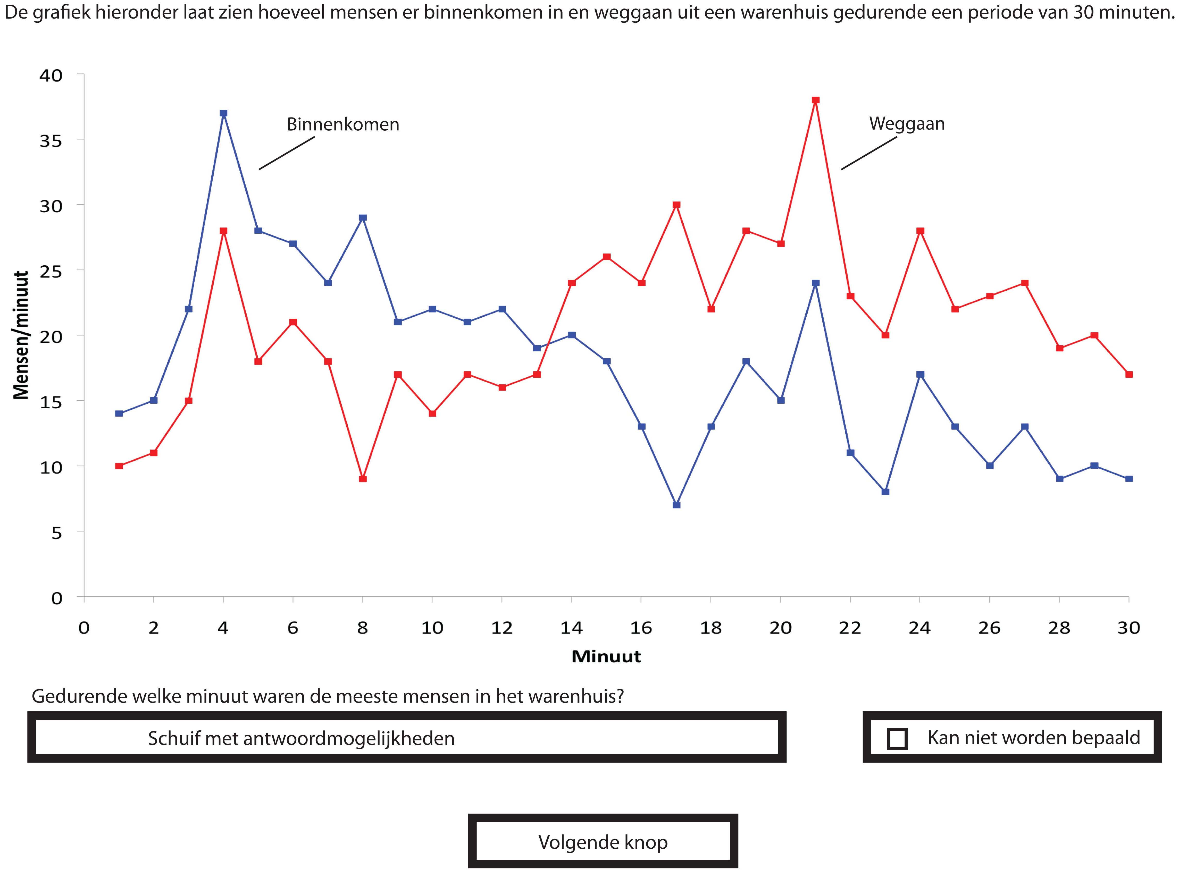
Method
Adjustments to the Department Store Task
        Translated in Dutch
        Resolution (1024x1280)
        Substitution of color of lines
        Split of questions over four screens
        Accompanying text moved to introduction screen
        Slide bar and ticking box
        After answering a (next) button was activated
        Repose screen
        Short break between questions
Notes:
the black line in the graph was substituted by a blue straight red in stead of dotted line
Splitting up the questions made it possible to examine the eye movements per question line, and the dotted red line by an unbroken line
Subsequently, the sentences of the original paper-and-pencil version: “Please answer the following questions” and “Check the box if the answer cannot be determined from the information provided” were transferred to an introduction screen, creating more space for the actual question.
The way the participants had to answer was also changed. They no longer had to fill in a conventional questionnaire; instead they answered by moving a slide bar. By this adjustment participants did not had to move their eyes away from the screen when answering.
The answering categories were located at virtually the same position as in the original task.
At the moment a participant had answered a question, a button was activated, enabling the participant to proceed with the next question. It was up to the participants when to proceed to the next question, so no time limits were imposed.
The repose screen was grey colored and had a black cross exactly in the middle of the screen. This black cross was explicitly positioned at a different point at the screen than the intersection point of the inflow and outflow lines in the graph. This was done on purpose, to prevent participants to get primed by this crossing point when they started to examine the graph.
Short break between the questions, minimizing the chance that the viewing behavior was affected by the examination of the preceding question.

Slide 26
Method
Apparatus, location, and setting
Eye tracker:
          Mobile Tobii T120
          Records movements of both eyes at 60Hz
          Connected to two laptops that registered and processed the eye movements
        At different locations at Radboud University,
        Tested for conditions in terms of space, background noise, and absence of direct sunlight: no differences
Notes:
The conditions at the different locations were similar in terms of available space, background noise, and absence of direct sunlight

Slide 27
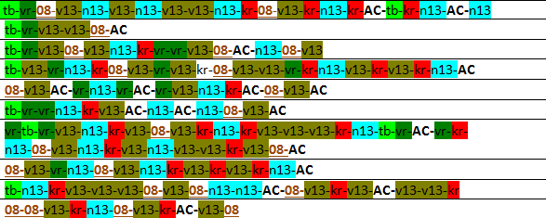
Method
Processing 1
        Exploring sequences of AOIs (Question 3)
Notes:
Used all kinds of approaches to get grip of the data.

Slide 28
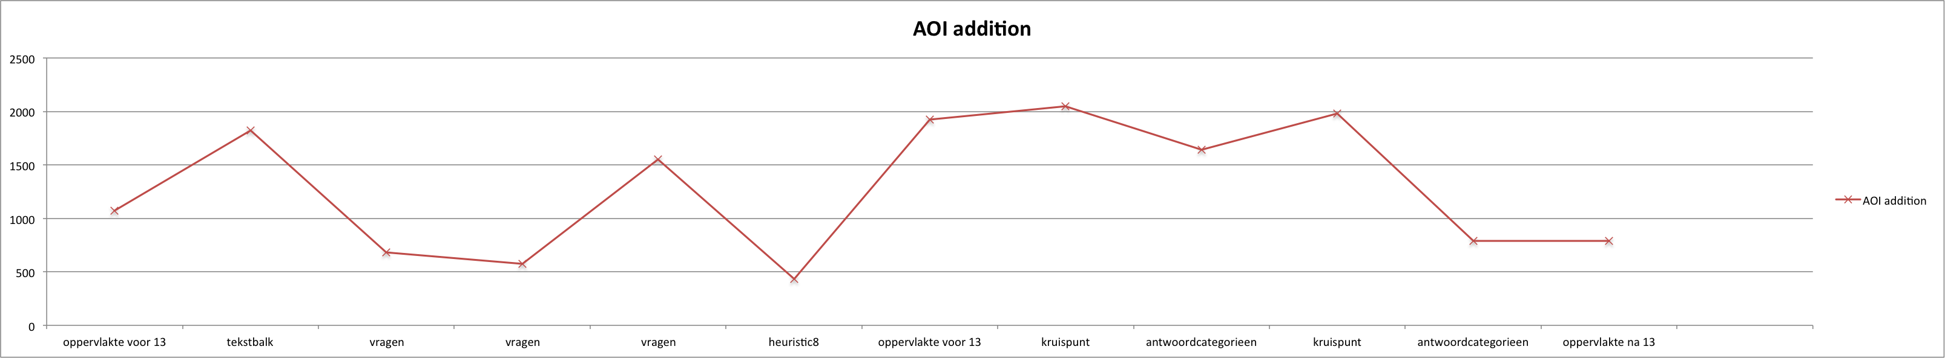
Method
Processing 2
        Graphs constructed with time in ms on the y-axis and AOIs in their processed order on the x-axis.
        Considering these viewing patterns which answers did these participants give to Q3, and why?
Notes:
Graphs were constructed of the processed data with time in ms on the y-axis and AOIs in their processed order on the x-axis. By means of the peaks in these graphs the viewing behavior of all participants was processed. This formed the basis of a qualitative analysis in which the answers to the four questions by the participants were also included. Besides a quantitative analysis was performed on fixation duration for a few AOIs Eye fixation: Duration (in ms)

Slide 29
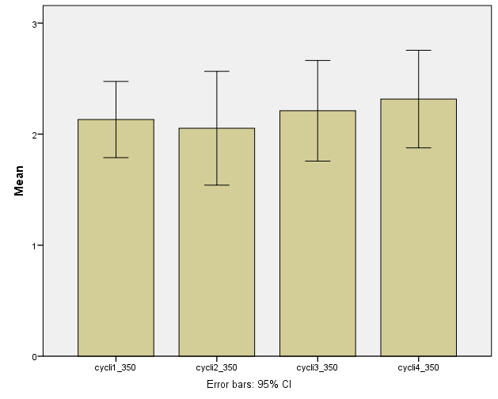
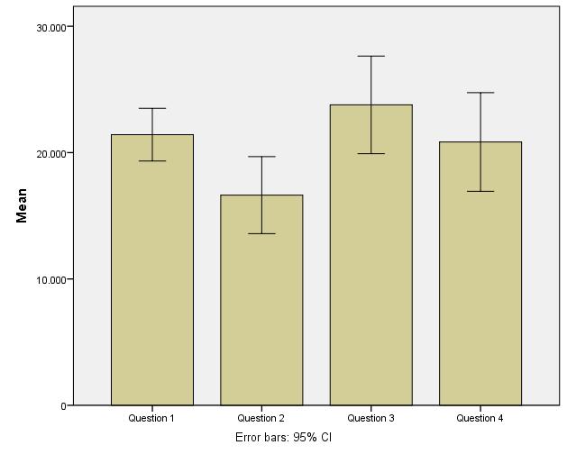
Results: descriptives
Viewing behavior
        Number of viewing cycles per question
            Q M SD
            1 2.13 1.04
            2 2.05 1.56
            3 2.21 1.38
            2.32 1.34
        Total time per question
            Q M SD
            1 21419 6348
            2 16631 9275
            3 23778 11755
            4 20842 11873

Slide 30
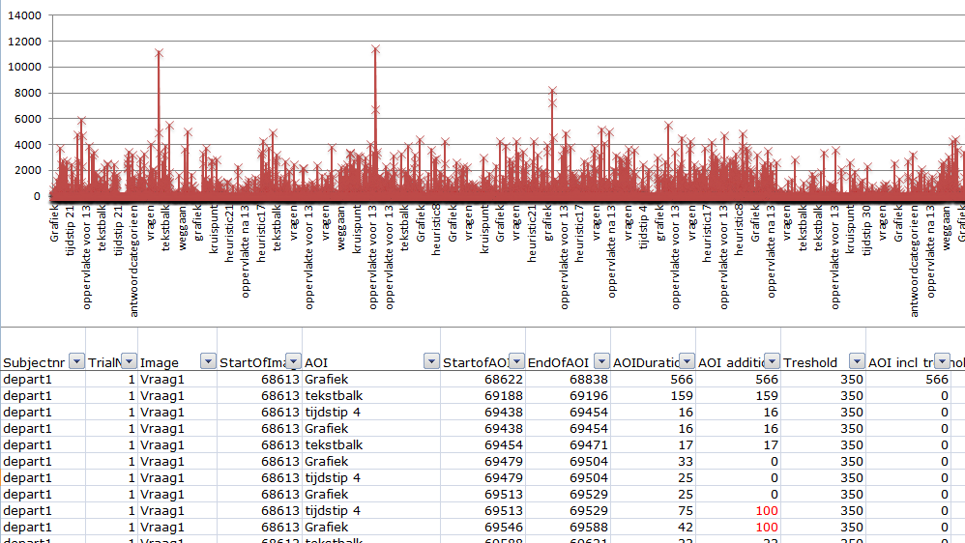
Method
Cleaning
        OutsideAOIs
        LOSS
        Summation of alternations
        Threshold 350 ms
Notes:
Relatively few participants also viewed outside the differentiated AOIs, these were registered as
Now and then the eye tracker did not register eye movements, for example when participants blinked; these were indicated as LOSS. For each LOSS it was established whether it belonged to an AOI or not. In the latter case the LOSS was removed from the data.
LOSS and outside AOIs removed by means of a script (algorithm)
Summation: participants looking at the bounderies of adjecent AOIs, summing up the alternations (as it may be below the threshold level)
Threshold, filtering out noise. (established in a iterative procedure). Of all thresholds, in steps of 50, ranging from 200 to 500, by means of paired t-tests we compared if there was a statisically significant difference in the number of viewing cycles that participants used in e.g. thresholds of 350 and 500 ms.
We hebben het aantal kijkcycli als indicator voor het informatiegehalte van de kijkpatronen.
Aantal kijkcycli bekeken omdat die worden afgesloten door antwoordcategorieën, daarmee wordt een denkcyclus afgesloten.
Van onder naar boven (200 met 250, 250 met 300) gewerkt en van boven naar onder.
Overgang van zowel 300 naar 350 voor elke vraag wijken de kijkcycli significant af. Bij elke andere overgang van 50 ms is dat niet het geval dat alle vragen significant afwijken.
Als niks significant zou zijn, zou het niet uitmaken waar je de grens trekt (treshold bepaald).
Van 350 naar 400 is niet alles significant meer verschillend. Voor 350 gekozen omdat daar het meeste informatie nog inzit.

Slide 31
Method
Iterative approach
        Answering behavior resulted in four different groups
        Groups formed basis for hypotheses on frequency, duration, cycle, temporal location, global
        Sequential analysis based on Poole and Roth (1989) → is dit de correcte term NEE op zoek naar een andere + theorie om in te bedden.
Notes:
Different approaches for analysing sequences are discussed, e.g. sequential analysis, markov analysis,
In line with Poole and Roth (1989), Weingart (1997) we used Phasic

Slide 32
Results: Viewing behavior, frequencies
        Correct answers
        H1a: Q3 frequency AOI ‘intersection’ group 1 > groups 2, 3, 4
          partial evidence: group 1 (M = 4.86) > group 3 (M = 1.86)
        H1b: Q4 frequency AOI ‘t30’ group 1 > groups 2, 3, 4
          evidence: group 1 (M = 2.71) > groups 2, 3, 4 (Ms = 0.17, 0.21, 0.45)
        Correlation heuristic
        H2a: Q3 frequency AOI ‘t8’ group 2 > groups 1, 3, 4
          evidence: group 2 (M = 3.83) > groups 1, 3, 4 (Ms = 1.86, 1.43, 1.73)
        H2b: Q4 frequency AOI ‘t17’ group 2 > groups 1, 3, 4
          evidence: group 2 (M = 4.17) > groups 1, 3, 4 (Ms = 1.14, 1.36, 1.82)

Slide 33
Results 2
Hs based on group differentiation: Duration
        Correct answers
        H3a: Q3 duration AOI ‘intersection’ group 1 > groups 2, 3, 4
          no evidence
        H3b: Q4 duration AOI ‘t30’ group 1 > groups 2, 3, 4
          no evidence
        Correlation heuristic
        H4a: Q3 duration AOI ‘t8’ group 2 > groups 1, 3, 4
          evidence: group 2 (M = 5038) > groups 1, 3, 4 (Ms = 2299, 1927, 2652)
        H4b: Q4 duration AOI ‘t17’ group 2 > groups 1, 3, 4
          partial evidence: group 2 (M = 3699) > groups 1, 3 (Ms = 1707, 1507)

Slide 34
Results 3
Hs based on group differentiation: Cycle
        Correct answers vs. correlation heuristic
        H5a: Q3 cycles group 1 > group 2
          no evidence
        H5b: Q4 cycles group 1 > group 2
          evidence: group 1 (M = 3.29) > group 2 (M = 1.50)

Slide 35
Results 4
Hs based on group differentiation: Temporal location
        Correct answers
        H6a: Q3 AOI ‘answer’ preceded by AOI ‘intersection’ group 1 > groups 2, 3, 4
          partial evidence, group 1 > group 2
        H6b: Q4 AOI ‘answer’ preceded by AOI ‘t30’ group 1 > groups 2, 3, 4
          no evidence
        Correlation heuristic
        H7a: Q3 AOI ‘answer’ preceded by AOI ‘t8’ group 2 > groups 1, 3, 4
          partial evidence: group 2 > group 1
        H7b: Q3 AOI ‘answer’ preceded by AOI ‘t17’ group 2 > groups 1, 3, 4
          no evidence
Notes:
H6a > betekent relatief vaker (omdat kruistabel)

Slide 36
Results
Summary hypotheses
Dimension | Subject | Hypotheses | Finding | Evidence
Frequency | Intersection | H1a: 1 > 2, 3, 4 | 1 > 3 | Partial
 | Time 30 | H1b: 1 > 2, 3, 4 | 1 > 2, 3, 4 | Full
 | Time 8 | H2a: 2 > 1, 3, 4 | 2 > 1, 3, 4 | Full
 | Time 17 | H2b: 2 > 1, 3, 4 | 2 > 1, 3, 4 | Full
Duration | Intersection | H3a: 1 > 2, 3, 4 | - | No
 | Time 30 | H3b: 1 > 2, 3, 4 | - | No
 | Time 8 | H4a: 2 > 1, 3, 4 | 2 > 1, 3, 4 | Full
 | Time 17 | H4b: 2 > 1, 3, 4 | 2 > 1, 3 | Partial
Cycle | Number Q3 | H5a: 1 > 2 | - | No
 | Number Q4 | H5b: 1 > 2 | 1 > 2 | Full
Temporal location | Intersection before answer | H6a: 1 > 2, 3, 4 | 1 > 2 | Partial
 | Time 30 before answer | H6b: 1 > 2, 3, 4 | - | No
 | Time 8 before answer | H7a: 2 > 1, 3, 4 | 2 > 1 | Partial
 | Time 17 before answer | H7b: 2 > 1, 3, 4 | - | No
Notes:
Temporal location: position of AOI in a cycle

Slide 37
Conclusions 2
        RQ2 Does viewing behavior prelude answering behavior, and if so, how?
          Four groups differentiated on basis answering behavior
          Viewing behavior and answering behavior are related:
            Frequency of looking at specific AOIs
              Correct answer Q4 t30, correlation heuristic Q3 and Q4
            Duration of looking at specific AOIs
              Correlation heuristic Q3
            Number of viewing cycles
              Correct answer Q4
            Temporal location
              Further exploration needed
          Viewing group 2 has explicit viewing behavior
Notes:
Without Outside AOIs and LOSSes

